Slide 1
COSP230 Ch. 2
Using the Android Studio Interface

Slide 2
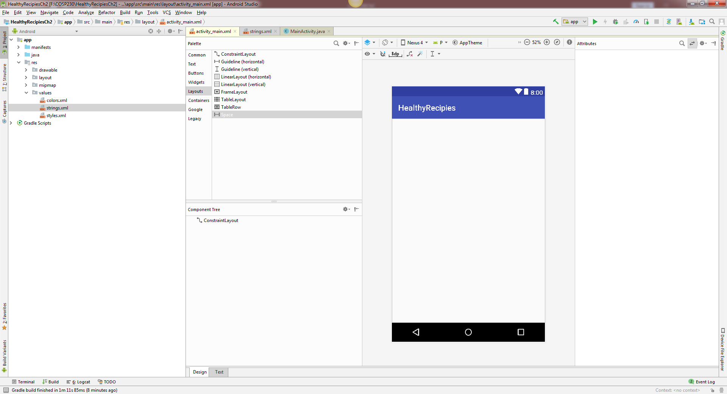
Start of Project (Delete HelloWorld text):

Slide 3
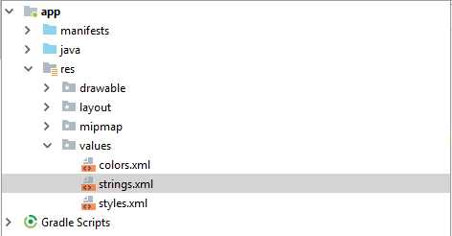
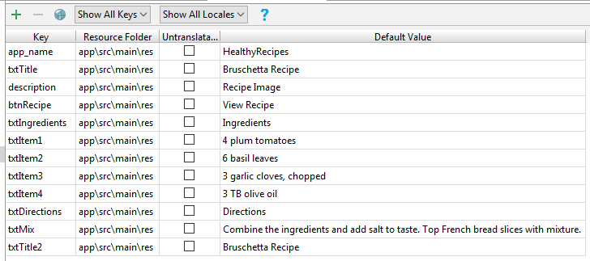
Go to strings.xml in values folder, open the Translation Editor, and enter the keys and their values as in the picture on the right.

Slide 4
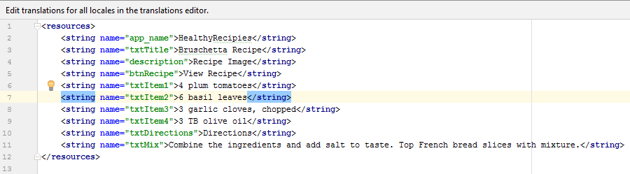
Click on strings.xml tab. It should look like this:

Slide 5
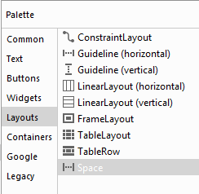
Linear and Relative Layouts
Linear Layout
Organizes layout components in a vertical column or horizontal row
Horizontal or Vertical
Relative Layout
Organizes layout components in relation to each other
Gives more flexibility in positioning controls than other layouts

Slide 6
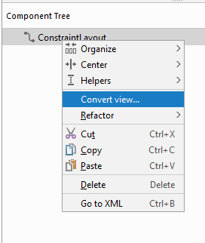
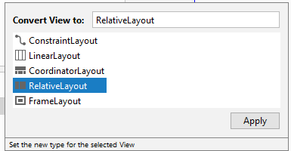
How to change to Relative Layout from Constraint Layout
In Component Tree, do the following:
Right-click ConstraintLayout
Select Convert view… from menu
Select RelativeLayout in Window
Click Apply button

Slide 7
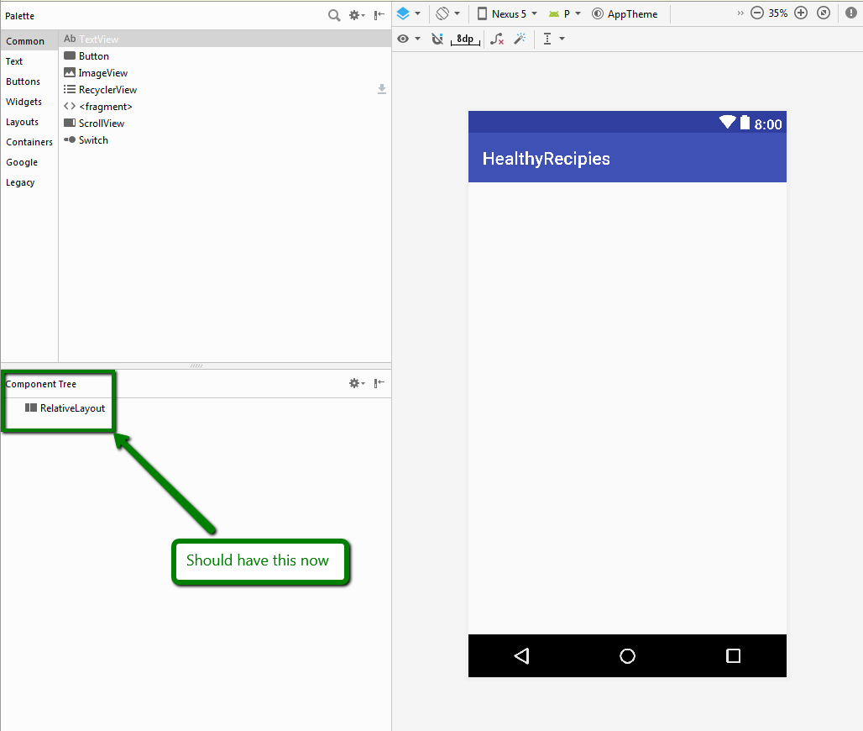
Should now have the following:

Slide 8
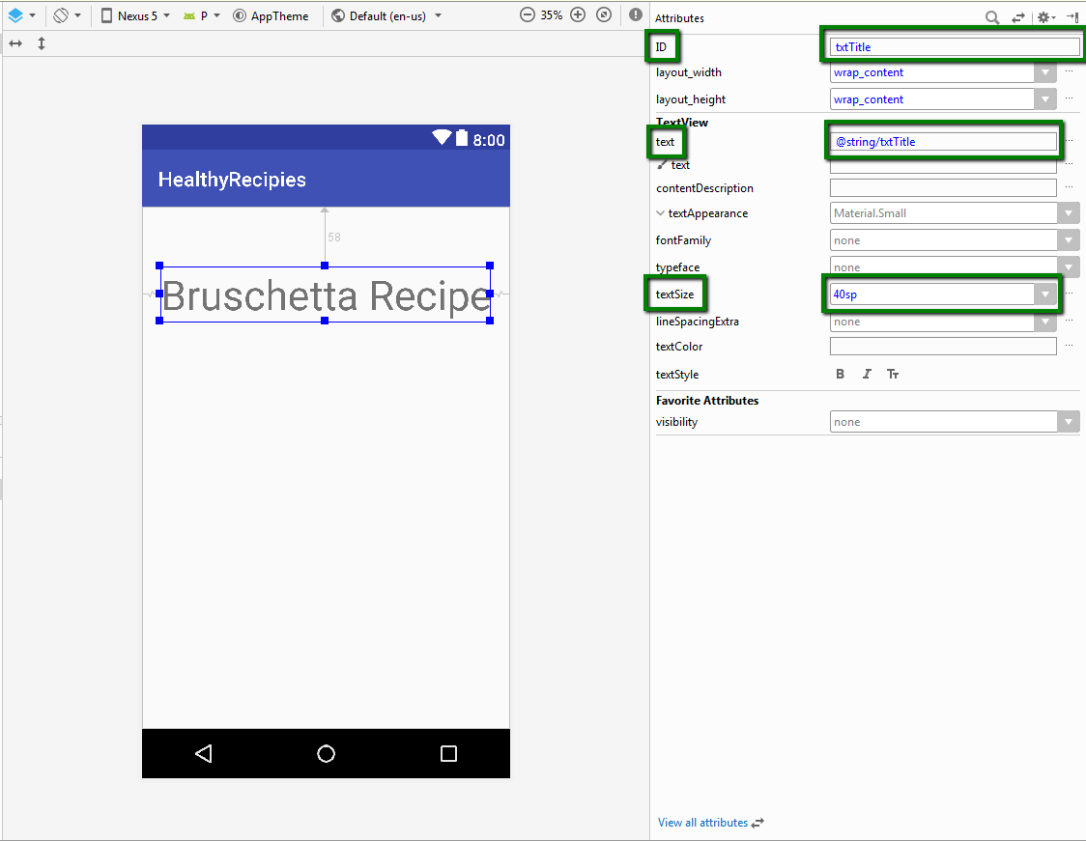
Add a TextView widget
In Palette, drag and drop a TextView widget into simulator
Found in either Common or Text categories
Make sure it is located near the top of the simulator
Change the attributes that are boxed in the picture
ID and textSize attributes are to be typed
Use Translations Editor to change text attribute

Slide 9
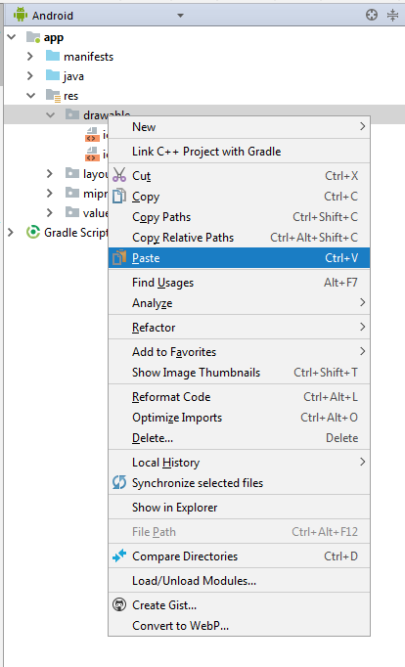
Add an image to the project
Download “bruschetta.png” from Files area
Right-click on the file and select “Copy”
Left-click arrow next to “res” folder
Right-click on “drawable” folder
Select Copy from menu
Android Studio will accept .png, .jpg, and .gif images
.png is preferred
.gif is discouraged

Slide 10
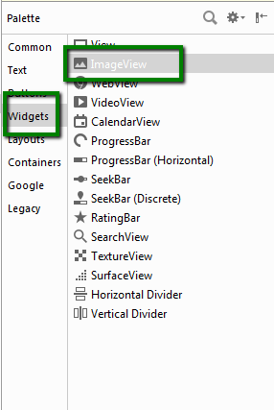
Add Image View Widget to proejct
Drag and drop an ImageView widget into the simulator
After doing this, a Resources window will appear.
Select the “bruschetta” image from the Project category.

Slide 11
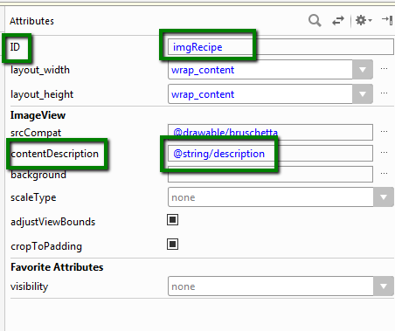
Change attributes for ImageView widget
Use the diagram on the right to change attributes to what is shown.

Slide 12
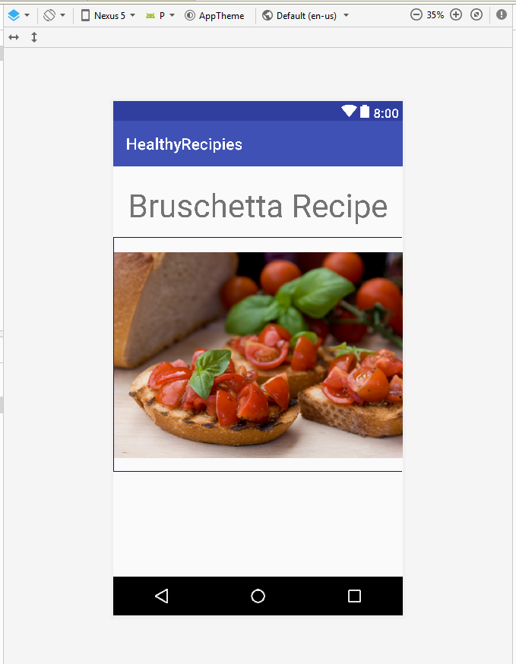
Now you should have this:

Slide 13
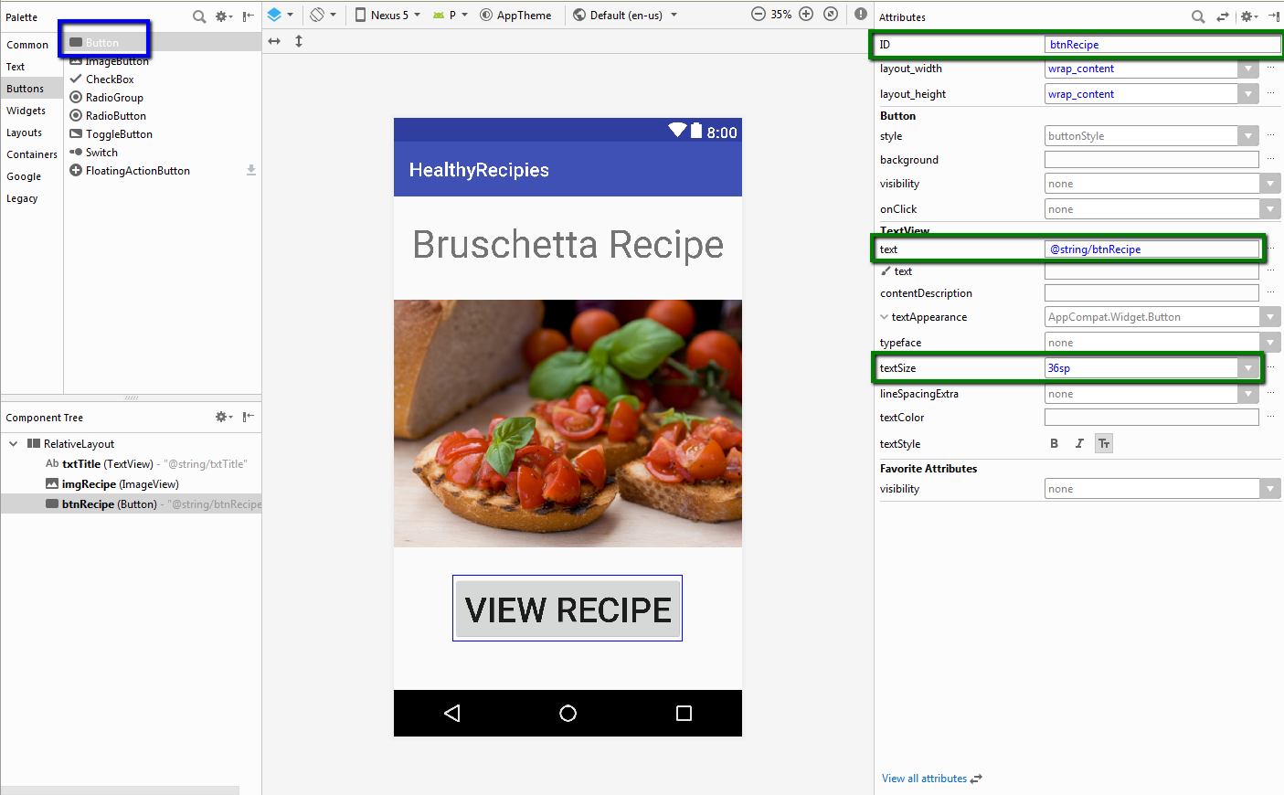
Add a button to the project
Drag and drop a Button to the bottom portion of the simulator
May have to move other two widgets
Change the attributes in green boxes to the values in the picture

Slide 14
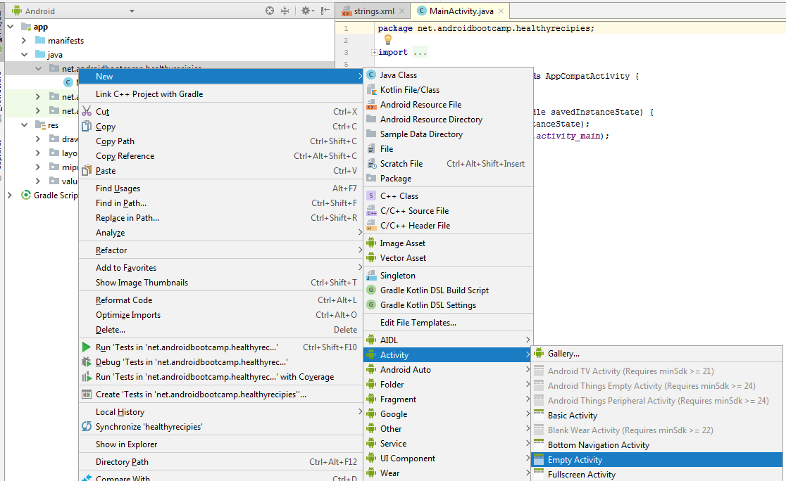
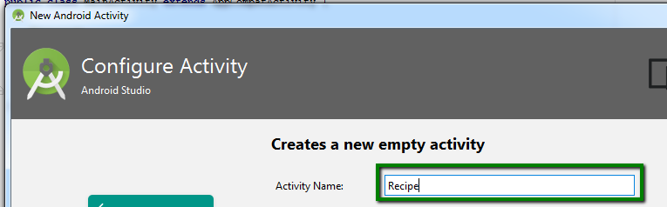
Add a second screen (Activity) to the project
Close the activity_main.xml tab
In the Project View, expand the java folder.
Expand first net.androidbootcamp.healthyrecipes selection
In menus, do the following:
Left-click New
Left-click Activity
Left-click Empty Activity
In Configure Activty, type Recipe for activity name.

Slide 15
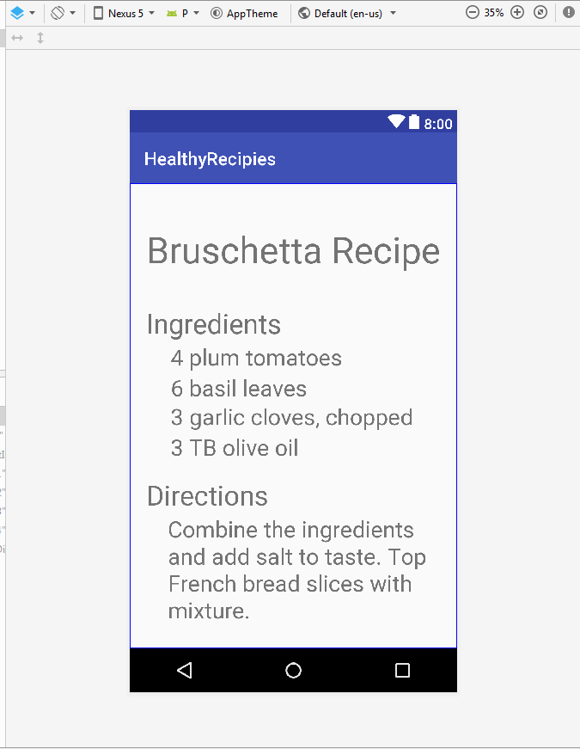
Add content to second screen
Change layout to RelativeLayout
You will need to add 8 TextView widgets, one at a time
Give them the same names as the keys defined in the Translations Editor
Text attributes should be set by clicking the three dots and selecting corresponding keys
Sizes should be as follows
40sp for top
30sp for “Ingredients” and “Directions” headers
25sp for everything else

Slide 16
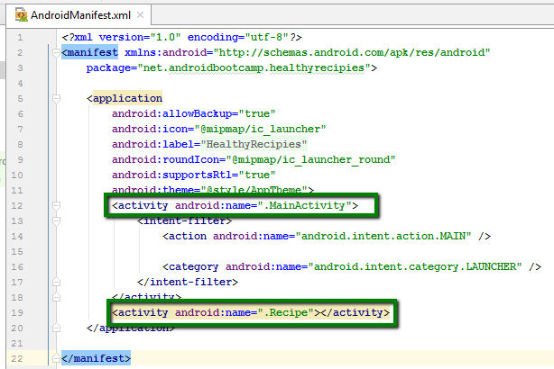
How will second screen be displayed? (Part 1)
Fortunately, Part 1 is done automatically.
Android Studio adds each activity that is created to the Android Manifest file.
This file must always be named AndroidManifest.xml
DON’T EVER CHANGE THE NAME OF THIS FILE!!!!

Slide 17
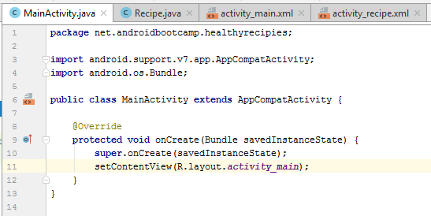
How will second screen be displayed? (Part 2)
A portion of Part 2 is done automatically.
When a user runs your app, the MainActivity.java code is the first thing read by the device processor.
MainActivity class is created
Within this class, an onCreate method is created, which places the new activity on the top of the execution stack
After this, the setContentView method is called to display the selected content
Looks for activity_main.xml, which is in Resources folder (that’s what the R means).

Slide 18
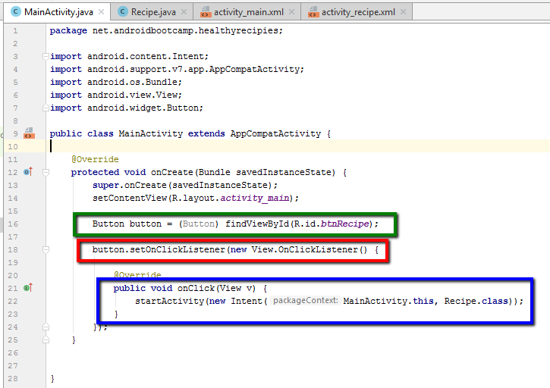
How will second screen be displayed? (Part 3)
Here’s the part you have to type.
You must code a Button event handler
Consists of three parts:
A Class property that holds a reference to the Button object
An OnClickListener() method that waits for the button click action
An onClick() method that responds to the click event
You will also need keystrokes to import the Button class.
Alt+Enter on Windows
Option+Return on MacOS

